Slide 1
Fact and Opinion
What’s the difference?
Why does it matter?

Slide 2
What is a fact?
A fact is something that can be proved and is supported by evidence.
Example: Water boils at 212 degrees Fahrenheit.
How can this be proved?
Would it make sense for someone to disagree?
Example: Zebras live in Africa.
How can this be proved?
Would it make sense for someone to disagree?

Slide 3
What is an opinion?
Opinions cannot be proved. An opinion is what someone things or feels about a subject. People can have different opinions about the same subject.
Example: Sloths are very interesting animals.
Can this be proved?
Could someone disagree?
Example: Soccer is a better sport than football.
Can this be proved?
Could someone disagree?

Slide 4
Why does it matter?
Where would you expect to find facts?
Where would you expect to find opinions?
Why is it important to know the difference?
Is it okay to have different opinions?
Persuasive speaking and writing has a mix of fact and opinion. Explain.

Slide 5
What facts do you know about your school? What opinions do you have about your school?

Slide 6
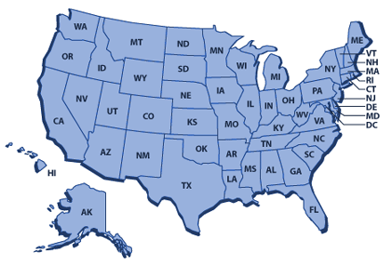
What facts do you know about the United States? What opinions do you have about the United States?

Slide 7
What facts do you know about the local football team? What opinions do you have about the local football team?

Slide 8
What words suggest “opinion”?
Favorite
Best
Worst
Coolest
Interesting
Boring
Funny
Hard
Easy

Slide 9
Let’s practice identifying fact and opinion. *Look for key “opinion” words.*
Which of these is a fact?
Climate change has consequences.
Orangutans are beautiful and interesting.
People are fascinated by peat forests.
The ten hottest years on record were recorded since 2000.

Slide 10
Can you identify the fact? *Which one can be proved with evidence?*
Which of these is a fact?
It’s silly to think that losing my job is the result of climate change.
Learning about climate change is so exciting!
Deforestation represents about 15% of greenhouse gas emissions.
The most difficult thing to watch in this episode was the corruption that is occurring in Indonesia related to deforestation.

Slide 11
Let’s wrap up!
Write 2 facts and 2 opinions about greening your school, related to one or more of the following impact areas.
Climate Change
Energy
Water
Biodiversity

